Slide 1

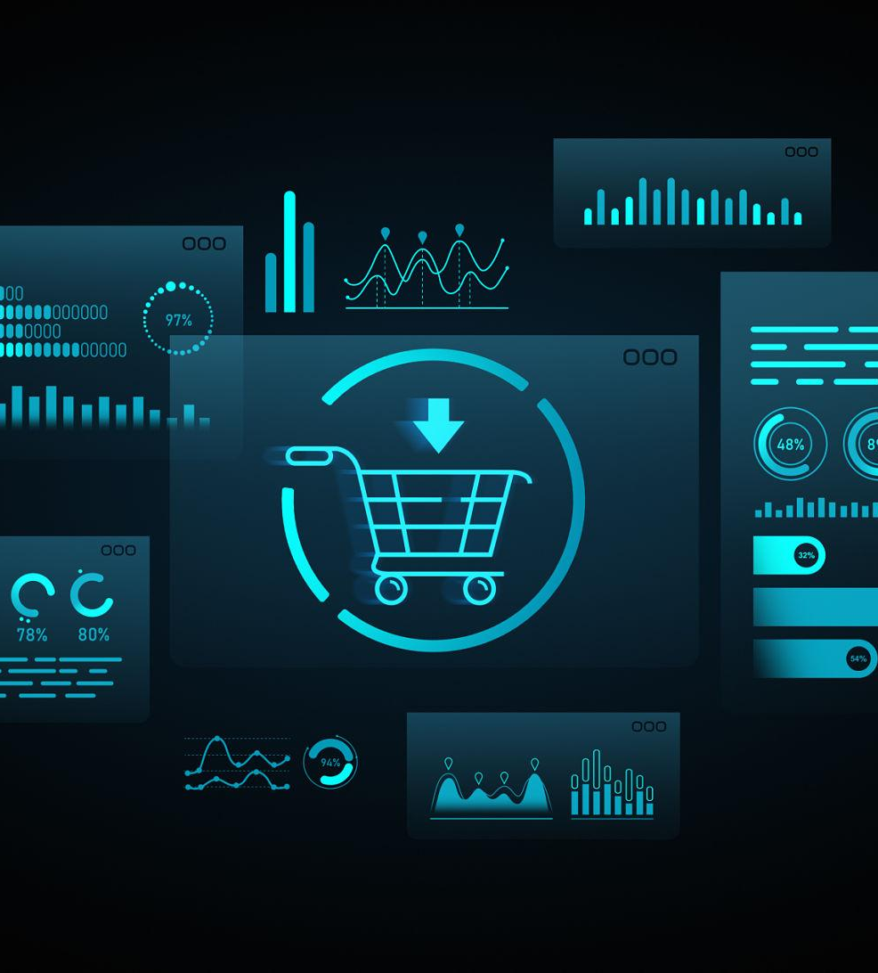

Ontology-Driven Data Agent for E-commerce

Slide 2
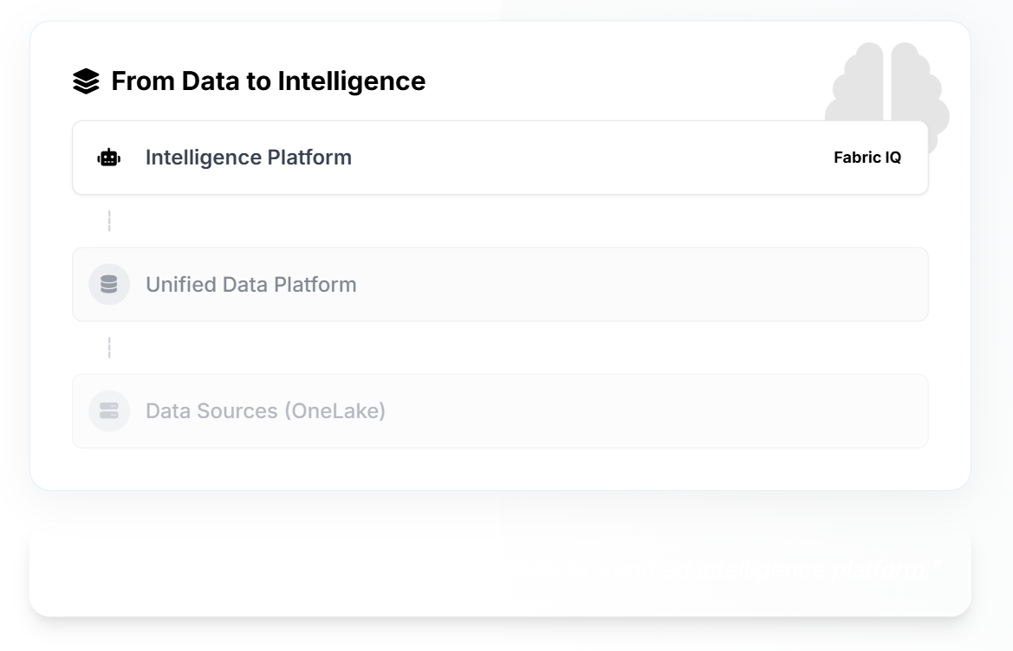
Introduction & Overview
Fabric IQ is the semantic intelligence layer in Microsoft Fabric that unifies data, business meaning, and actions.
Force Multiplier for Your Data Estate
Not a replacement, but an enhancement for your existing Fabric and One Lake investments, adding a layer of intelligence over raw data.
Shared, Real-Time Business Model
Defines entities, relationships, rules, and actions in a unified ontology that reflects how your business actually operates.
Grounded AI & BI Semantics
Ensures Al agents and Bl reports speak the same language, providing consistent, explainable, and trustworthy insights.

Slide 3
Fabric IQ & Ontology
Fabric IQ is a semantic and ontology-driven layer built on top of Fabric data and Power BI semantic models, enabling AI agents to reason, query, and explain enterprise data correctly
Relationship Between Fabric IQ and Ontology
Think of it this way:
Ontology = Business meaning & definitions
Fabric IQ = System that uses ontology to power AI & analytics
Simple analogy
Ontology = Dictionary + rulebook
Fabric IQ = Brain that reads the dictionary and answers questions
Ontology is a structured semantic model that defines entities, attributes, relationships, metrics, business rules, and context, enabling AI reasoning and accurate query interpretation
Why Fabric IQ + Ontology is Critical for AI
Without Ontology | With Fabric IQ Ontology
AI guesses meanings | AI understands intent
Same question → different answers | Uses correct definitions
Copilot explanations are inconsistent | Explains results clearly and correctly

Slide 4
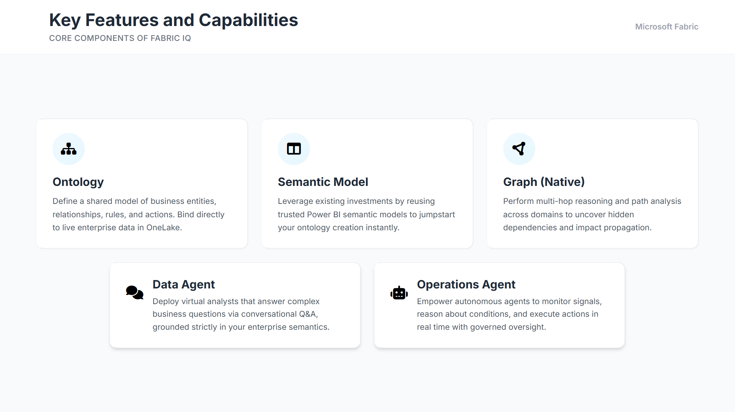
Key Features and Capabilities
Core Components of Fabric IQ
Ontology
Define a shared model of business entities, relationships, rules, and actions. Bind directly to live enterprise data in One Lake.
Semantic Model
Leverage existing investments by reusing trusted Power BI semantic models to jumpstart your ontology creation instantly.
Graph (Native)
Perform multi-hop reasoning and path analysis across domains to uncover hidden dependencies and impact propagation.
Data Agent
Deploy virtual analysts that answer complex business questions via conversational Q&A, grounded strictly in your enterprise semantics.
Operations Agent
Empower autonomous agents to monitor signals, reason about conditions, and execute actions in real time with governed oversight.

Slide 5

How Fabric IQ Works
Architecture & Ecosystem Integration
Fabric IQ Core
Ingest/Store
Model
Analyze
Act
One Lake Data
Ontology
Power BI
Operations Agent
Lakehouse's
Graph
Notebooks
Activator
Event houses
Semantic Models
Copilot
Data Agent
Real-Time Intelligence
Work IQ (M365)
Foundry IQ

Slide 6
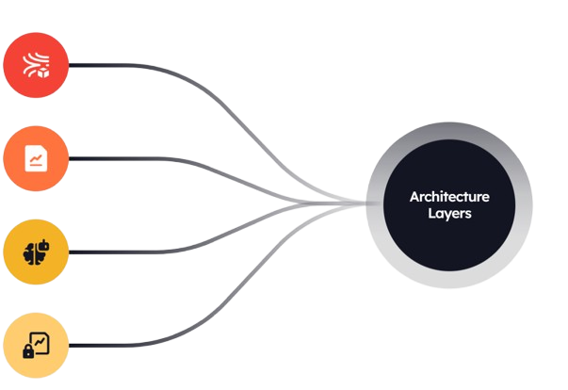
Architecture Layer
Data Foundation
One Lake stores all raw and curated e-commerce data in the standardized Delta file format.
Semantic Layer
Defines clear relationships between orders, customers, and products for model consistency.
Ontology Logic
Provides AI with business context, ensuring revenue calculation excludes all returns.
Unified Security
Fabric maintains strict security and access controls during all AI-powered data queries.

Slide 7
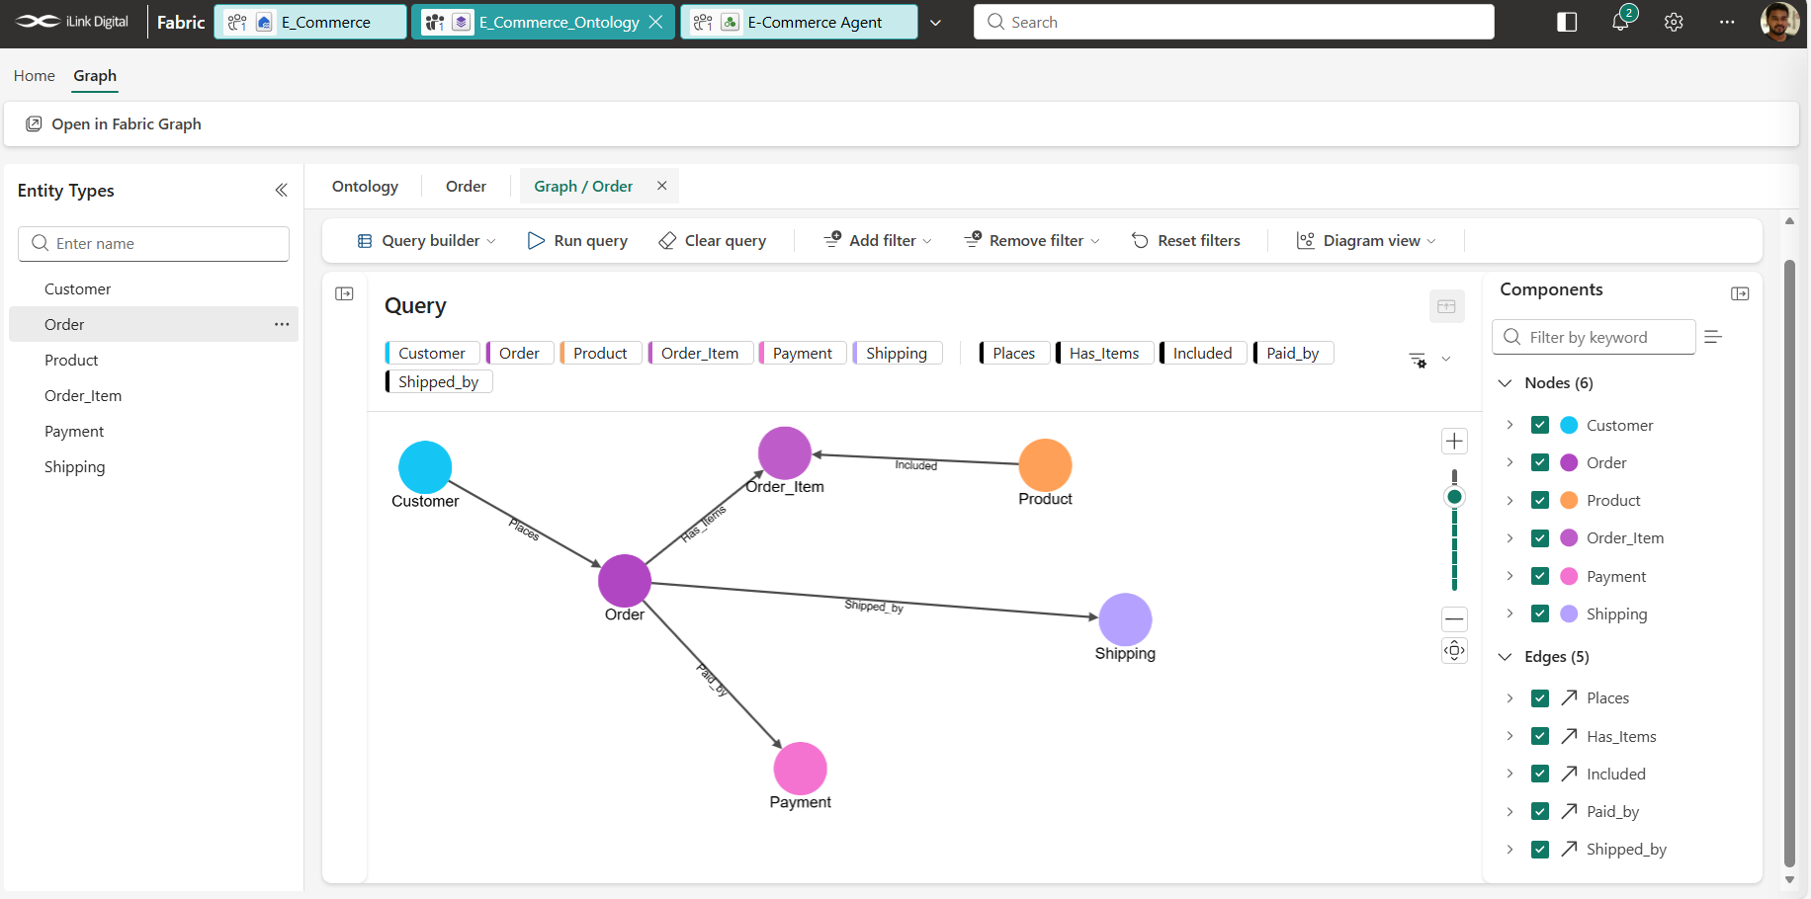
Unified E-commerce Ontology & Relationship Graph
Overview
This graph represents a connected e-commerce data model built using an ontology in Microsoft Fabric.
It links key business entities such as Customers, Orders, Products, Payments, and Shipping through meaningful relationships
Business Value
Enables cross-domain insights across the entire customer journey
Supports multi-step reasoning (Customer → Order → Product → Payment → Shipping)
Powers AI-driven data agents for natural language queries
Eliminates data silos by creating a unified, relationship-driven model

Slide 8
Unified E-commerce Ontology & Relationship Graph
Unified e-commerce ontology connecting customers, orders, products, payments, and shipping for AI-driven insights.
A relationship-driven e-commerce model enabling intelligent, cross-domain insights through Fabric Data Agent.
Connected e-commerce data graph powering AI to answer complex business questions instantly.
End-to-end e-commerce relationships transformed into actionable insights using ontology and AI.
From data to decisions: a unified e-commerce graph enabling natural language analytics.

Slide 9
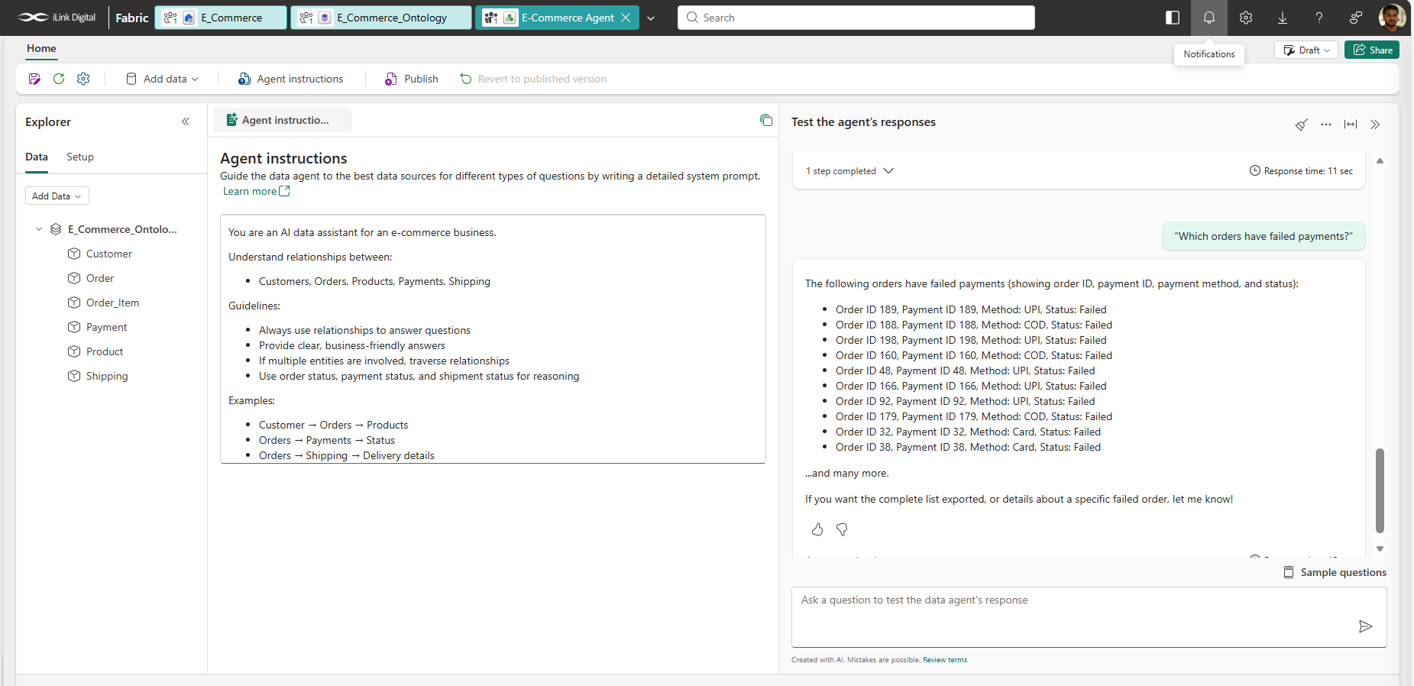
Data Agent
AI-powered Fabric Data Agent answering complex e-commerce queries using ontology-driven relationships.
From question to insight: Fabric Data Agent delivering real-time answers across connected e-commerce data.
Natural language queries powered by ontology—unlocking instant insights from e-commerce data.
Fabric Data Agent transforming connected data into actionable business answers instantly.
Ask anything, get insights: AI agent leveraging e-commerce ontology for intelligent decision-making

Slide 10
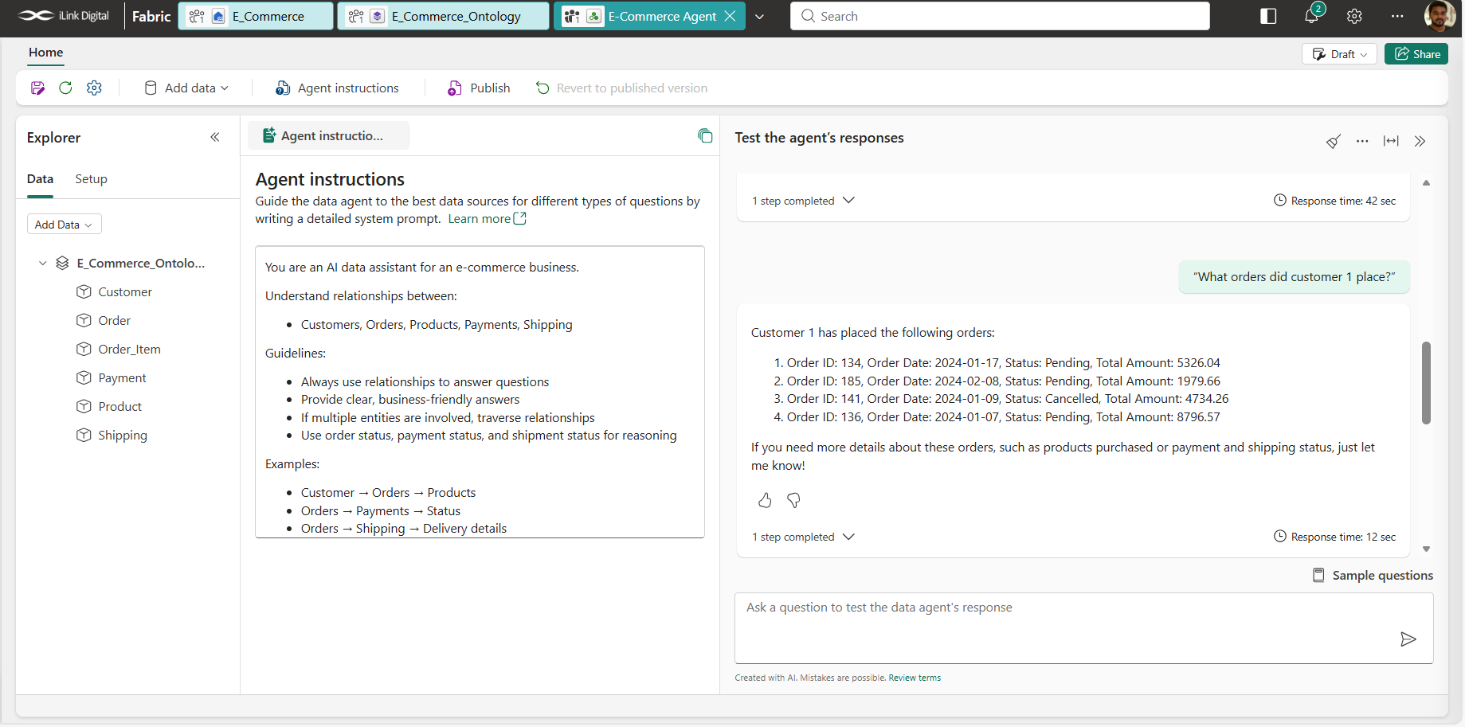

Slide 11
